Slide 1
Design, OO approach
“Systems Analysis and Design, I”
By Prof. Peter Khaiter
Extended and modified by Ferreiras
V1.0
November 2011

Slide 2
Reading suggested by Ferreiras
Before, please read¹:
➢ Designing the Data Access Layer, pages 446-450;
➢ Designing the View Layer, pages 450-454;
➢ Updating and Packaging the Design Classes, pages 457-461;
➢ Implementation issues for three-layer design, pages 450-454;
➢ Hybrid Object-Relational Database Design, pages 510-514;
1: System Analysis and Design In a Changing Word

Slide 3
Topics
Design Patterns and the Use Case Controller
Use Case Realization
Designing with Sequence Diagrams
Object Responsibility
Developing a Multilayer Design
Approaches to Data Access Layer
Designing the View Layer
Designing with Communication Diagrams
Package Diagram
Three-Layer Design
Design Patterns

Slide 4

Design Patterns and the Use Case Controller
Design pattern
  A standard solution template to a design requirement that facilitates the use of good design principles
Use case controller pattern
  Design requirement is to identify which problem domain class should receive input messages from the user interface for a use case

Slide 5
Design Patterns and the Use Case Controller (continued)
  Solution is to choose a class to serve as a collection point for all incoming messages for the use case. Controller acts as intermediary between outside world and internal system
  Artifact – a class invented by a system designer to handle a needed system function, such as a controller class

Slide 6
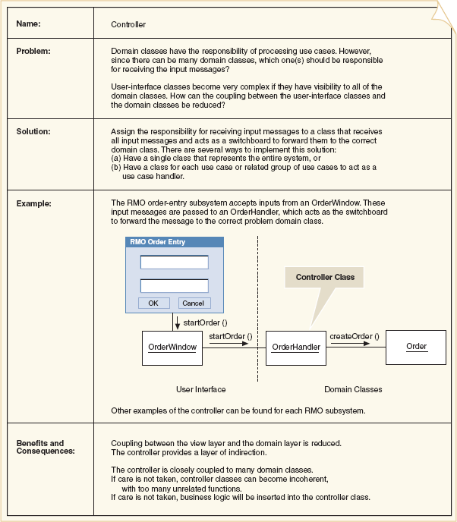
Use Case Controller Pattern

Slide 7
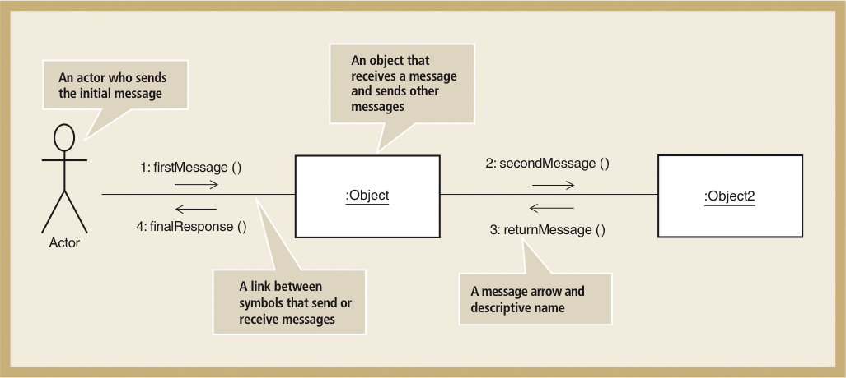
Use Case Realizations

Slide 8
Use Case Realization with Sequence Diagrams
Realization of use case done through interaction diagram development
Determine what objects collaborate by sending messages to each other to carry out use case
Sequence diagrams and communication diagrams represent results of design decisions
  Use well-established design principles such as coupling, cohesion, separation of responsibilities

Slide 9
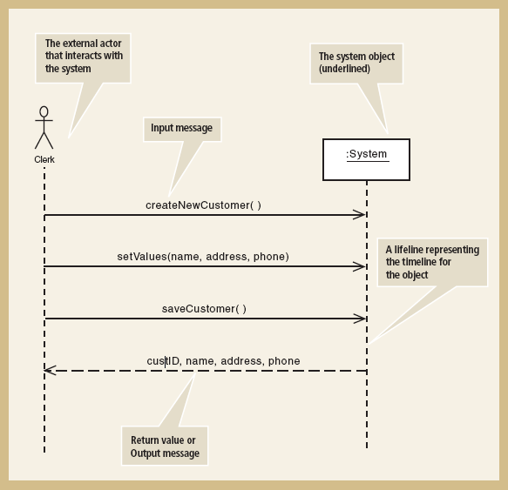
Understanding Sequence Diagrams (SSDs)

Slide 10
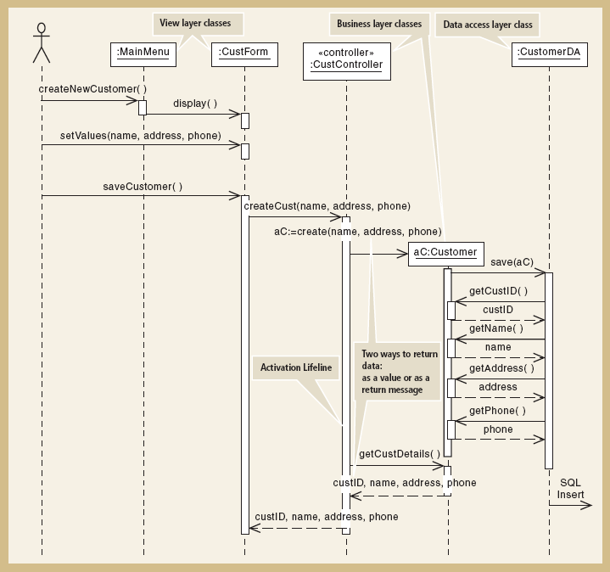
Detailed Sequence Diagram

Slide 11
Designing with Sequence Diagrams
Sequence diagrams used to explain object interactions and document design decisions
Document inputs to and outputs from system for single use case or scenario
Capture interactions between system and external world as represented by actors
Inputs are messages from actor to system
Outputs are return messages showing data

Slide 12
Object Responsibility
Objects are responsible for system processing
Responsibilities include knowing and doing
  Knowing about object’s own data and other classes of objects with which it collaborates to carry out use cases
  Doing activities to assist in execution of use case
    Receive and process messages
    Instantiate, or create, new objects required to complete use case
Design means assigning responsibility to the appropriate classes based on design principles and using design patterns

Slide 13
First-Cut Sequence Diagram
Start with elements from SSD
Replace :System object with use case controller
Add other objects to be included in use case
  Select input message from the use case
  Add all objects that must collaborate
Determine other messages to be sent
  Which object is source and destination of each message?

Slide 14
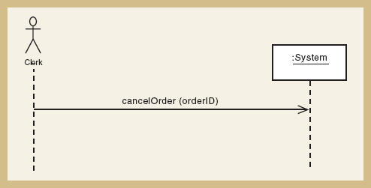
SSD for Cancel an Order

Slide 15
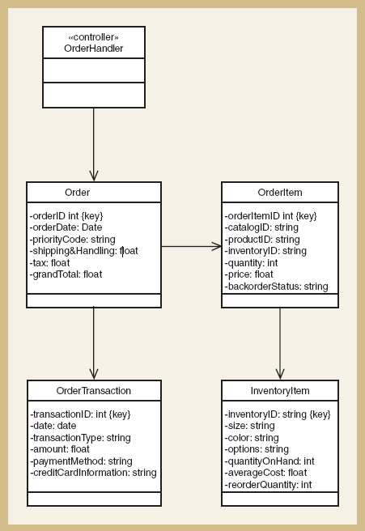
First Cut Design Class Diagram
for Cancel an Order

Slide 16
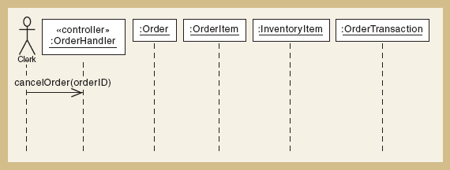
Potential Objects for Cancel an Order

Slide 17
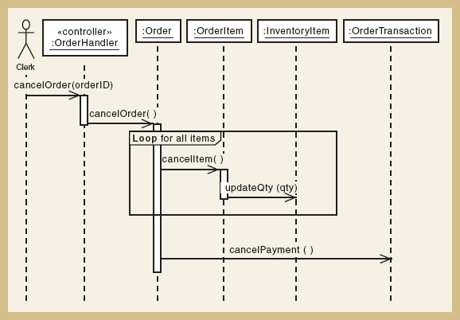
First Cut Sequence Diagram for Cancel an Order

Slide 18
Guidelines for Sequence Diagram Development for Use Case
Take each input message and determine internal messages that result from that input
  For that message, determine its objective
  Needed information, class destination, class source, and objects created as a result
  Double check for all required classes
Flesh out components for each message
  Iteration, guard-condition, passed parameters, return values

Slide 19
Assumptions About First-Cut Sequence Diagram
Perfect technology assumption
  Don’t include system controls like login/logout (yet)‏
Perfect memory assumption
  Don’t worry about object persistence (yet)‏
  Assume objects are in memory ready to work
Perfect solution assumption
  Don’t worry about exception conditions (yet)‏
  Assume happy path/no problems solution

Slide 20
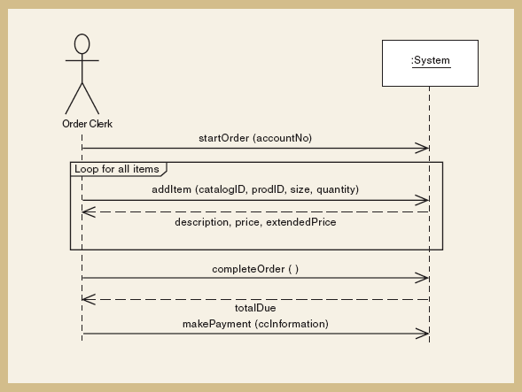
SSD for Create new phone order

Slide 21
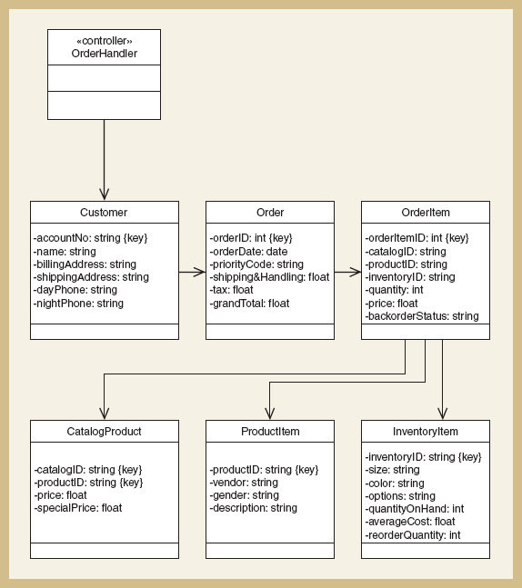
First cut DCD for Create new phone order

Slide 22
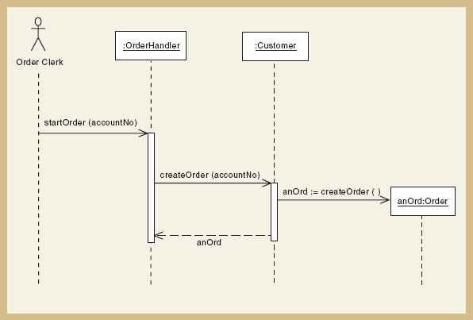
Sequence Diagram for First Input Message

Slide 23
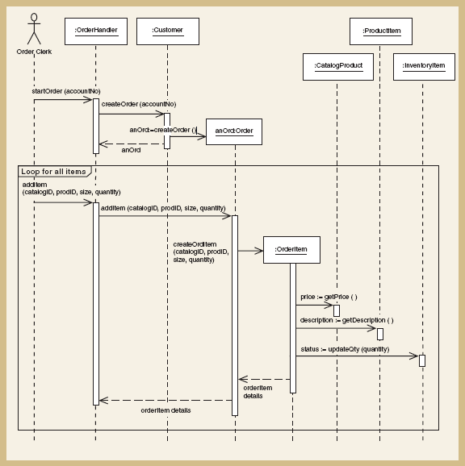
Sequence Diagram for First and Second Input Messages

Slide 24
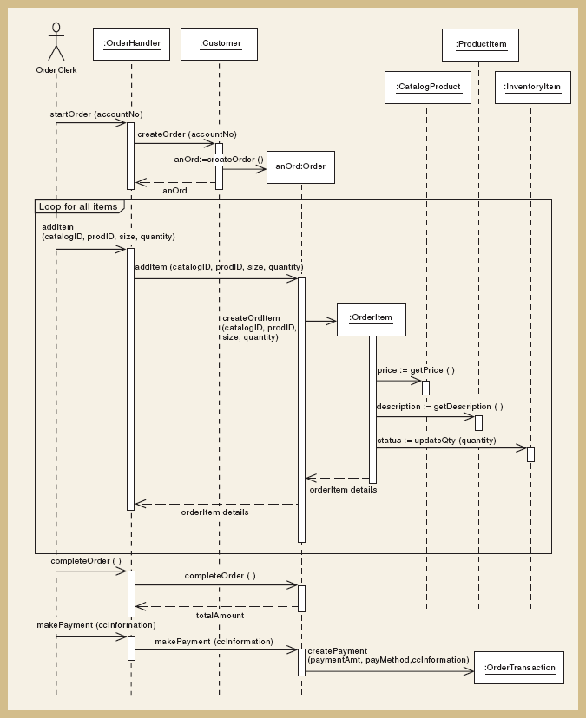
Complete Sequence Diagram

Slide 25
Developing a Multilayer Design
First-cut sequence diagram – use case controller plus classes in domain layer
Add data access layer – design for data access classes for separate database interaction
  No more perfect memory assumption
  Separation of responsibilities
Add view layer – design for user-interface classes
  Forms added as windows classes to sequence diagram between actor and controller

Slide 26
Data Access Layer (DAL)¹
A data access layer (DAL) is a layer of a computer program which provides simplified access to data stored in persistent storage of some kind, such as an entity-relational database.
1) Added by Ferreiras From http://en.wikipedia.org/wiki/Data_access_layer

Slide 27
Data Access Layer (DAL)¹
For example, the DAL might return a reference to an object (in terms of object-oriented programming) complete with its attributes instead of a row of fields from a database table. This allows the client (or user) modules to be created with a higher level of abstraction. This kind of model could be implemented by creating a class of data access methods that directly reference a corresponding set of database stored procedures. Another implementation could potentially retrieve or write records to or from a file system. The DAL hides this complexity of the underlying data store from the external world.
1) Added by Ferreiras From http://en.wikipedia.org/wiki/Data_access_layer

Slide 28
Data Access Layer (DAL)
Applications using a data access layer can be either database server dependent or independent. If the data access layer supports multiple database types, the application becomes able to use whatever databases the DAL can talk to. In either circumstance, having a data access layer provides a centralized location for all calls into the database, and thus makes it easier to port the application to other database systems (assuming that 100% of the database interaction is done in the DAL for a given application).
Object-Relational Mapping tools provide data layers in this fashion, following the active record model. The ORM/active-record model is popular with web frameworks.

Slide 29
Data Access Object (DAO)¹
This article is about the data access object design pattern in object-oriented software design.
In computer software, a data access object (DAO) is an object that provides an abstract interface to some type of database or persistence mechanism, providing some specific operations without exposing details of the database. It provides a mapping from application calls to the persistence layer. This isolation separates the concerns of what data accesses the application needs, in terms of domain-specific objects and data types (the public interface of the DAO), and how these needs can be satisfied with a specific DBMS, database schema, etc. (the implementation of the DAO).
1) Added by Ferreiras from http://en.wikipedia.org/wiki/Data_Access_Object

Slide 30
Data Access Object (DAO)
This design pattern is equally applicable to most programming languages, most types of software with persistence needs and most types of database, but it is traditionally associated with Java EE applications and with relational databases accessed via the JDBC API because of its origin in Sun Microsystems' best practice guidelines[1] ("Core J2EE Patterns") for that platform.

Slide 31
Data Access Object (DAO)
Advantages
The advantage of using data access objects is the relatively simple and rigorous separation between two important parts of an application that can and should know almost nothing of each other, and which can be expected to evolve frequently and independently. Changing business logic can rely on the same DAO interface, while changes to persistence logic do not affect DAO clients as long as the interface remains correctly implemented.

Slide 32
Data Access Object (DAO)
In the specific context of the Java programming language, Data Access Objects as a design concept can be implemented in a number of ways. This can range from a fairly simple interface that separates the data access parts from the application logic, to frameworks and commercial products.

Slide 33
Data Access Object (DAO)
DAO coding paradigms can require some skill. Use of technologies like Java persistence technologies and JDO ensures to some extent that the design pattern is implemented. Technologies like Enterprise JavaBeans come built into application servers and can be used in applications that use a JEE application server. Commercial products like TopLink are available based on Object-relational mapping (ORM). Popular open source ORM products include Hibernate, Ebean, pureQuery, iBATIS and Apache OpenJPA.

Slide 34
Data Access Object (DAO)
The expected benefit of use of Data Access Objects in a Java scenario is:
Improved efficiency and performance of the data layer since it is standard reusable software.
Modifications can be made to the DAO implementation without altering other decoupled modules of the application.a

Slide 35
Object - Relational Mapping¹
Object-relational mapping (ORM, O/RM, and O/R mapping) in computer software is a programming technique for converting data between incompatible type systems in object-oriented programming languages. This creates, in effect, a "virtual object database" that can be used from within the programming language. There are both free and commercial packages available that perform object-relational mapping, although some programmers opt to create their own ORM tools.
1) Added by Ferreiras from http://en.wikipedia.org/wiki/Object-relational_mapping

Slide 36
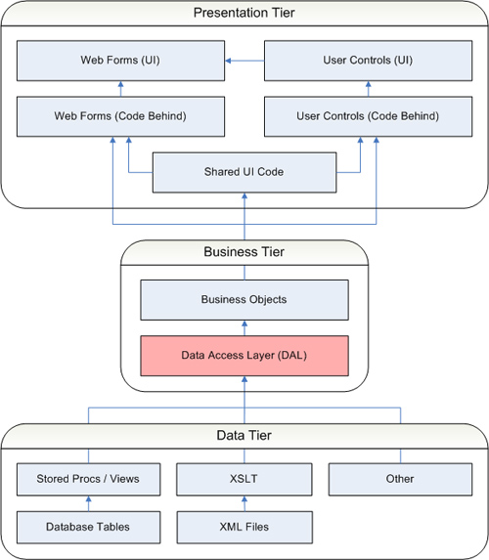
I recommend you read this article fully.
http://www.simple-talk.com/dotnet/.net-framework/.net-application-architecture-the-data-access-layer/

Slide 37
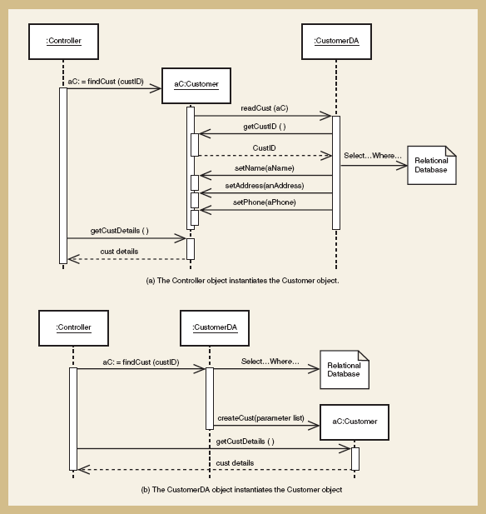
Approaches to Data Access Layer

Slide 38
Approaches to Data Access Layer (continued)‏
Create data access class for each domain class
  CustomerDA added for Customer
  Database connection statements and SQL statements separated into data access class. Domain classes do not have to know about the database design or implementation
Approach (a) – controller instantiates new customer aC; new instance asks DA class to populate its attributes reading from the database

Slide 39
Approaches to Data Access Layer (continued)‏
Approach (b) – controller asks DA class to instantiate new customer aC; DA class reads database and passes values to customer constructor
  Two following examples use this approach

Slide 40
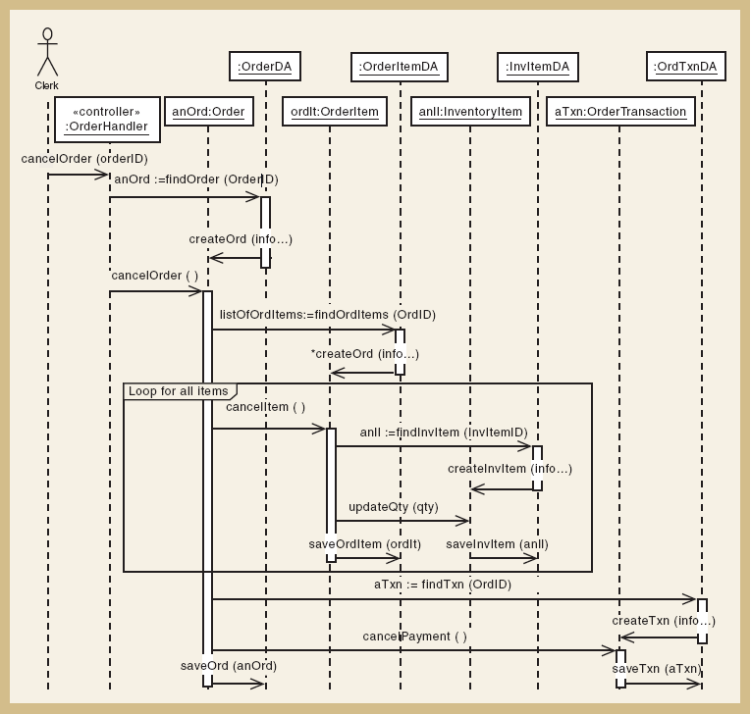
Adding Data Access Layer for Cancel an order

Slide 41
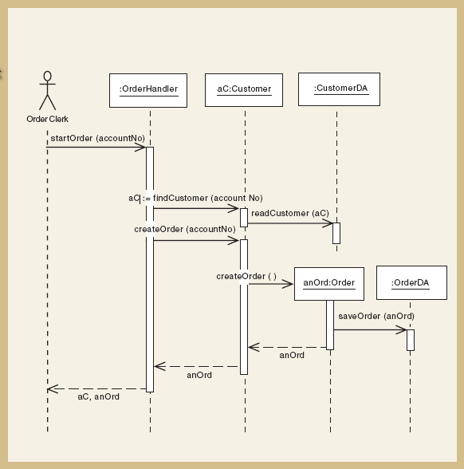
Create new phone order problem domain and data access

Slide 42
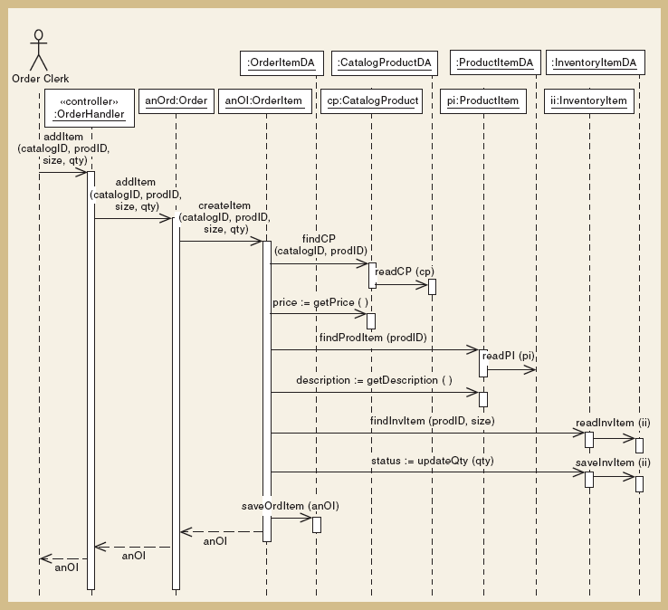
Create new phone order
Second input message

Slide 43
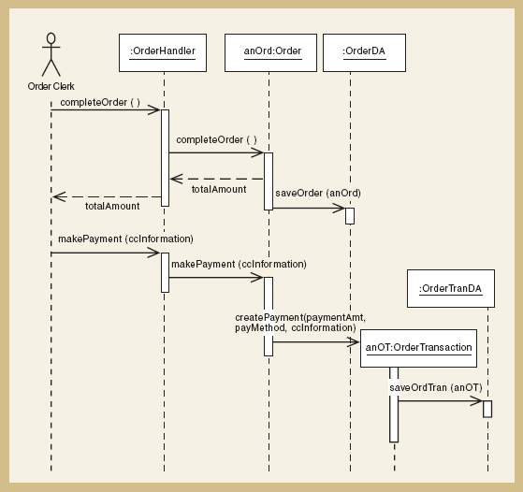
Create new phone order
Final Input Messages

Slide 44
Designing the View Layer
Add GUI forms or Web pages between actor and controller for each use case
  Minimize business logic attached to a form
Some use cases require only one form; some require multiple forms and dialog boxes
View layer design is focused on high-level sequence of forms/pages – the dialog
Details of interface design and HCI in Chapters 13 and 14

Slide 45
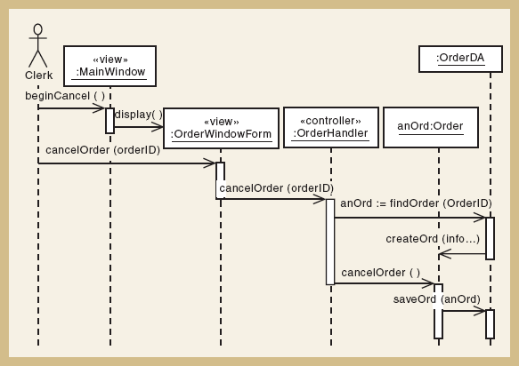
Cancel an order with view layer

Slide 46
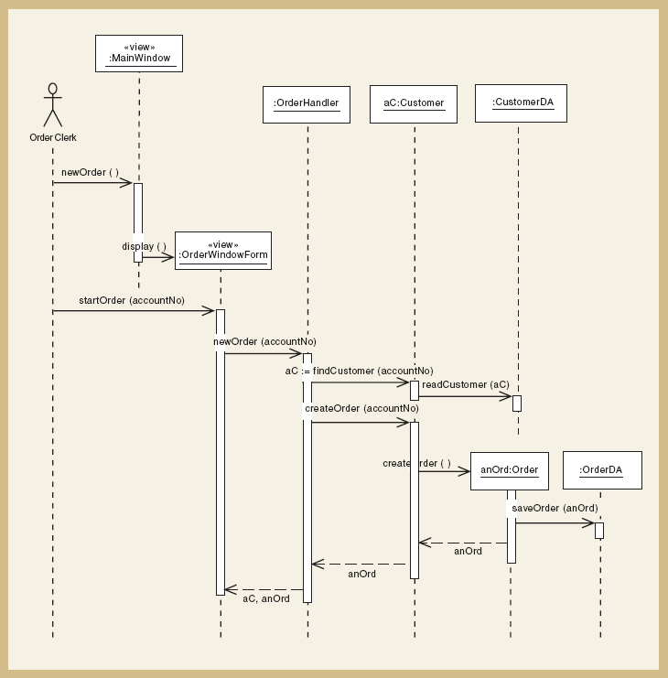
Create new phone order with view layer

Slide 47
Designing with Communication Diagrams
Communication diagrams and sequence diagrams
  Both are interaction diagrams
  Both capture same information
  Process of designing is same for both
Model used is designer’s personal preference
  Sequence diagram – use case descriptions and dialogs follow sequence of steps
  Communication diagram – emphasizes coupling

Slide 48
The Symbols of a Communication Diagram

Slide 49
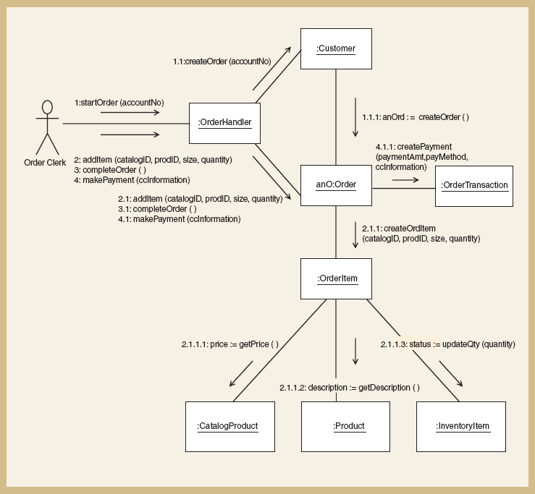
A Communication Diagram for
Create new phone order

Slide 50
Updating the Design Class Diagram
Design class diagrams developed for each layer
  New classes for view layer and data access layer
  New classes for domain layer use case controllers
Sequence diagram’s messages used to add methods
  Constructor methods
  Data get and set method
  Use case specific methods

Slide 51
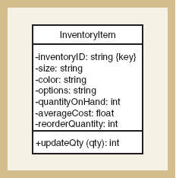
Design Class with Method Signatures, for the InventoryItem Class

Slide 52
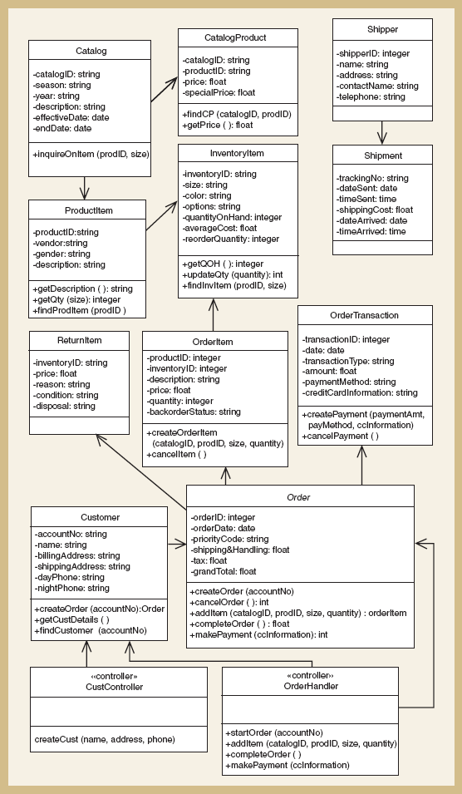
Updated Design Class Diagram
for the Domain Layer

Slide 53
Package Diagram—Structuring the Major Components
High-level diagram in UML to associate classes of related groups
Identifies major components of a system and dependencies
Determines final program partitions for each layer
  View, domain, data access
Can divide system into subsystem and show nesting within packages

Slide 54
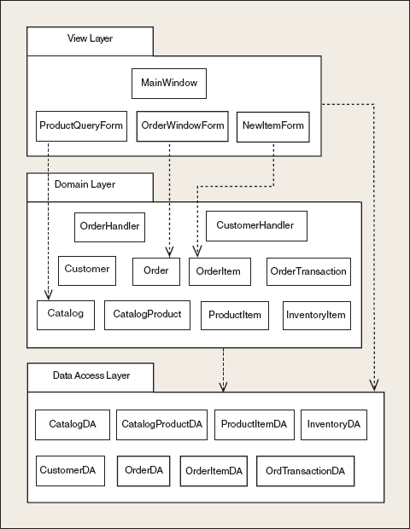
Partial Design of Three-Layer Package Diagram for RMO

Slide 55
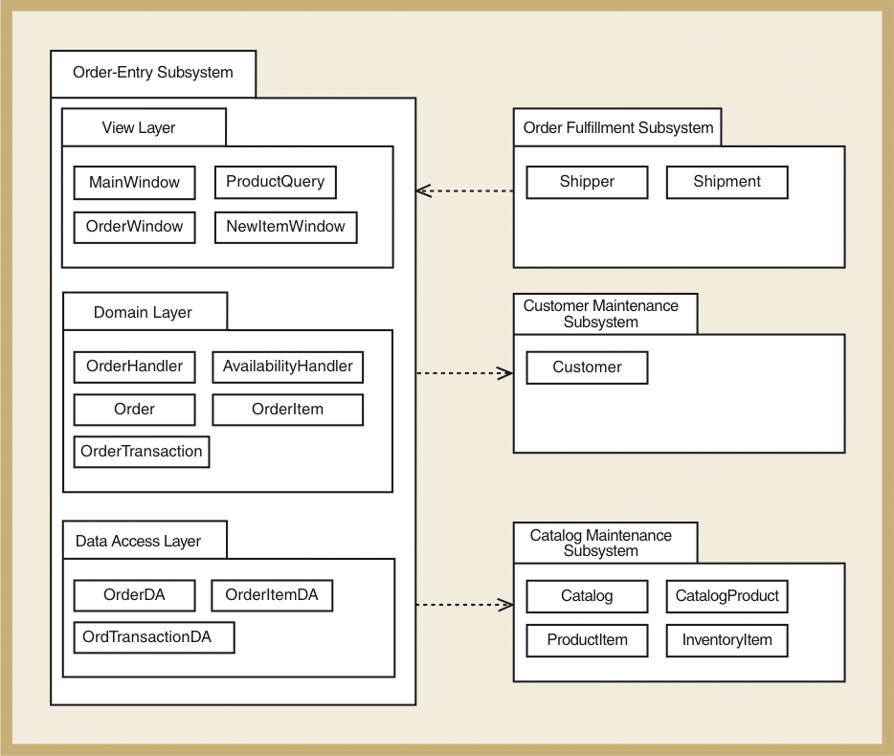
RMO Subsystem Packages

Slide 56
Implementation Issues for Three-Layer Design
Construct system with programming
  Java or VB .NET or C# .NET
  IDE tools (Visual Studio, Rational Application Developer, JBuilder)
Integration with user-interface design, database design, and network design
Use object responsibility to define program responsibilities for each layer
  View layer, domain layer, data access layer

Slide 57
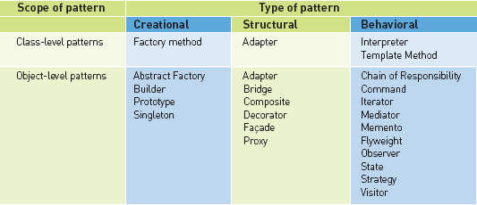
Design Patterns

Slide 58
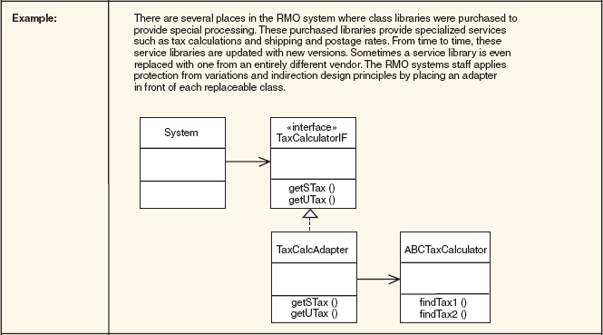
Adapter Pattern

Slide 59
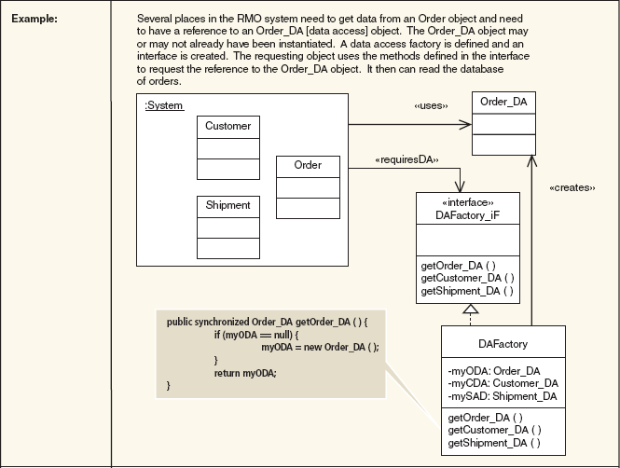
Factory or Factory Method Pattern

Slide 60
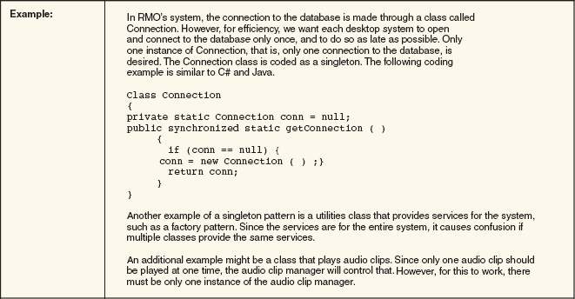
Singleton Pattern

Slide 61
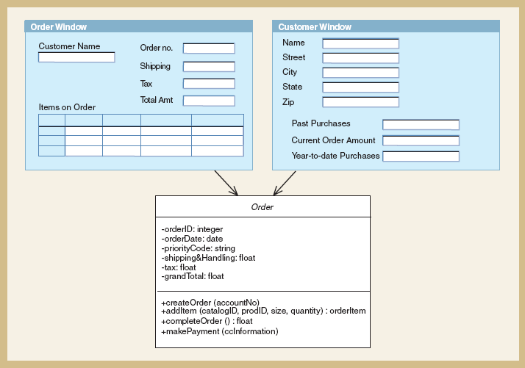
Create new order -- Observers

Slide 62
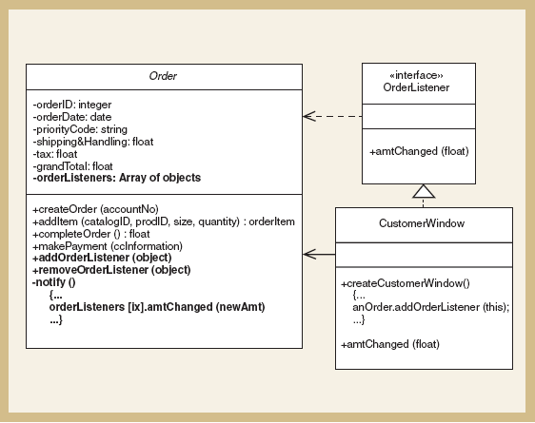
Implementation of Observer Pattern

Slide 63
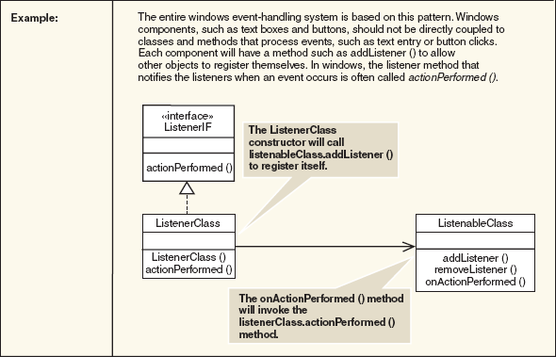
Observer Pattern

Slide 64
Readings
Today’s lecture: Chapter 12 – “Use Case Realizations”
For next lecture: Chapter 14,15 – “User Interface and System Security and Controls”
Thank you !!!

Slide 65
Reference added by Ferreiras, :-)
Systems Analysis and Design I
ITEC 3010 A - York University
http://www.math.yorku.ca/~cysneiro/ITEC3010AF2009.htm
Required Textbook:
Systems Analysis and Design in a Changing World
by John W. Satzinger, Robert Jackson and Stephen Burd
published by Course Technology, 2000
(ISBN: 0-7600-5879-2)

Slide 66

 I think we must, now, add some artifacts to your deliverables. Please see updated requirements for the final project.
 I think that is enough. Do you think too?

Slide 67

Bye, until next time, happy Christmas and happy new year 2012
Now, It is
time of
November 26, 2011

